Slide 1
Azure App Registration Setup for DSS Framework to connect DevOps and D365 CE
Instructions

Slide 2
Introduction
This document describes the configuration of an Azure App Registration which is used as identity in the Service connection / Library „DSS Secrets“ of Azure Dev Ops to run DSSFramework Pipelines successfully.

Slide 3
Prerequisites
The following steps/configurations are required to complete the setup of the App Registration.
The User must have permission to create an App Registration in the Active Directory (Tenant)
The User must have permission to create App User in D365 CE
The User must have access to DevOps Secrets (Setup 3)
The User must be familiar with DSS Framework (Setup 4)
The naming conventsions for the projects must be defined to avoid renamins at a later point in time. If you dont have conventions, check the Microsoft Recommendations.

Slide 4
Setup 1
Azure App Registration

Slide 5
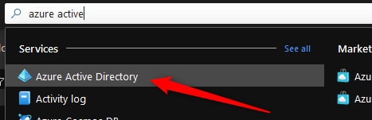
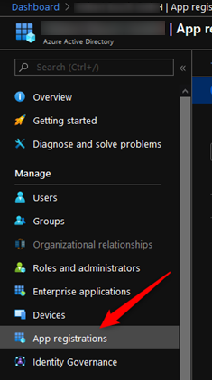
Steps - Active Directory (1/6)
As first step, the App Registration must be created incl. a secret.
Open the Azure Portal (https://portal.azure.com), search for „Azure Active Directory“ and select the entry
Select „App registrations“ in the navigation on the left hand side.

Slide 6
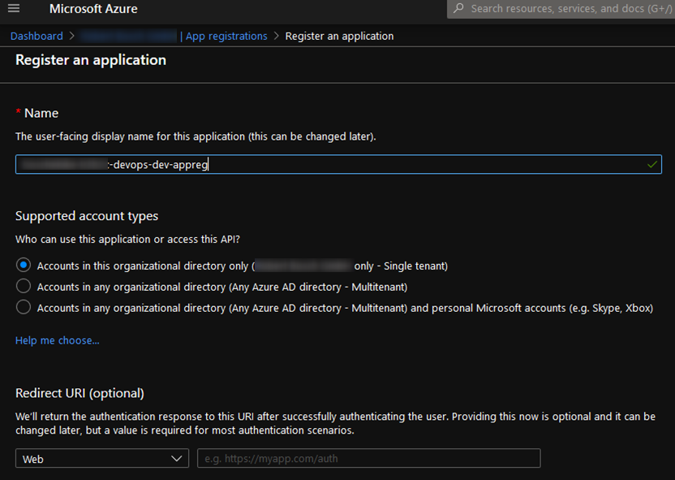
Steps - Active Directory (2/6)
Select „+ New registration“ and enter the name of the principal and click „Register“

Slide 7
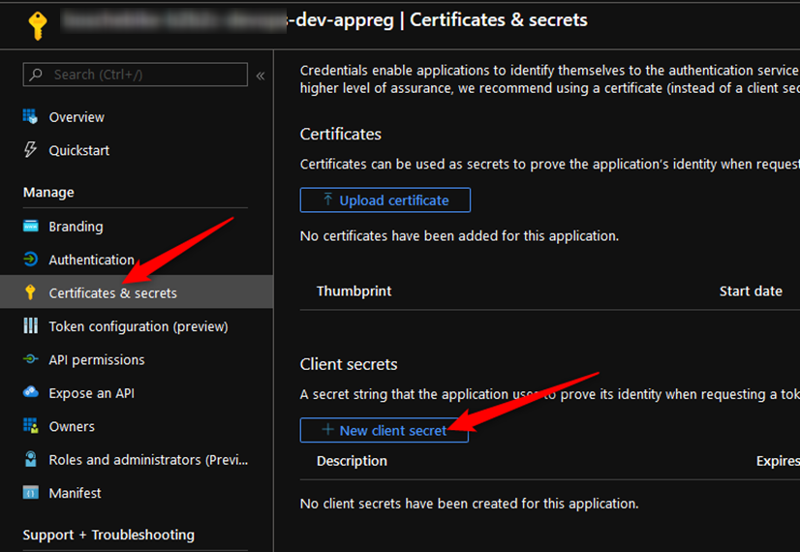
Steps - Active Directory (3/6)
Select Certificates & secrets“ in the navigation on the left hand side and click „+ New client secret“

Slide 8
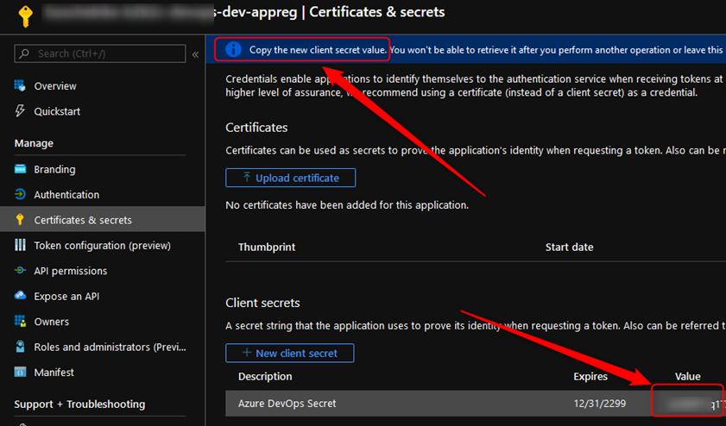
Steps - Active Directory (4/6)
Set the following properties and click „Add“
Description: e.g. „Azure DevOps Secret“
Expires: Never (to be discussed with Customer)
IMPORTANT: Copy your secret value to your project key storage/vault. You cannot fetch this secret afterwards!
Note: If the generated password starts or ends with [ ] or „ please recreate it, since this may lead to issues in the Azure Devops Pipelines.

Slide 9
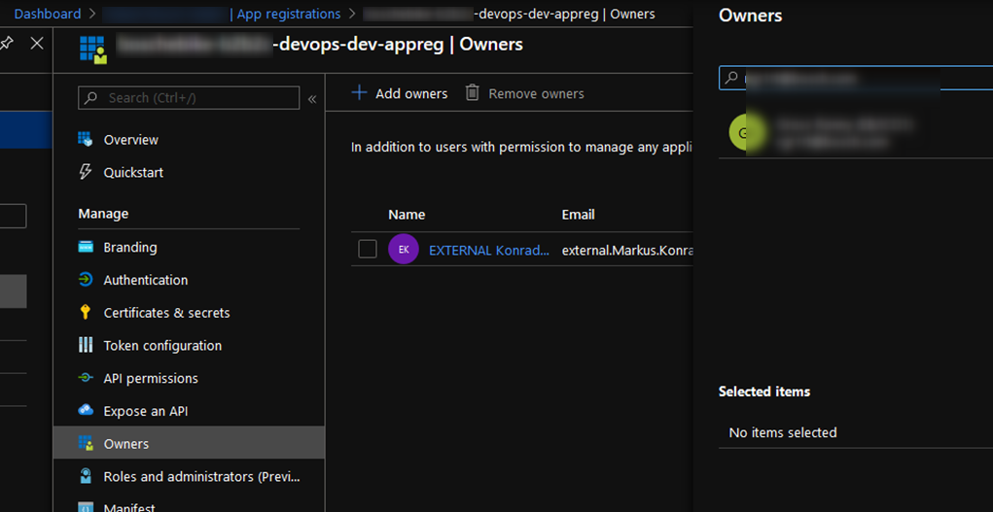
Steps - Active Directory (5/6)
[Optional] Set owner of App Registrations to Customer counterpart (e.g. IT-PM) by clicking on „Owners“ and select the Customer counterpart by „Add owners“.
Note: This is just a recommendation and some IT-Departments are expecting this step.

Slide 10
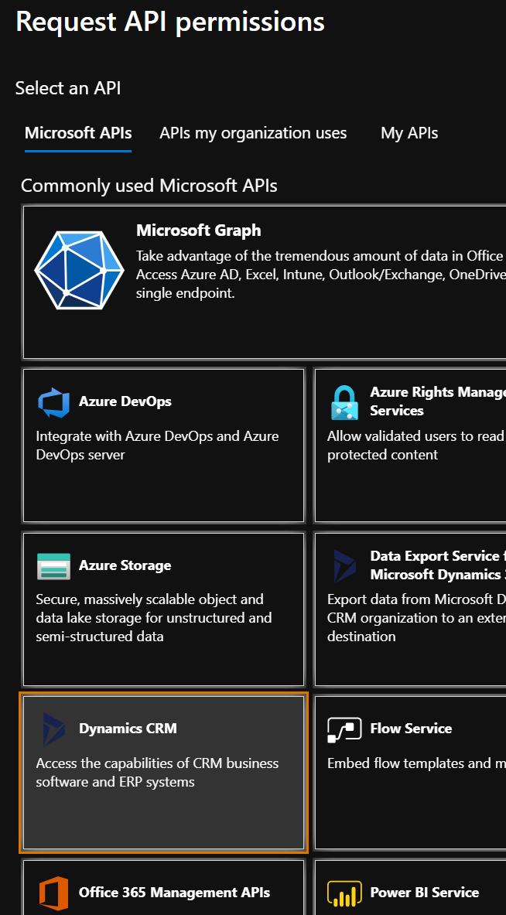
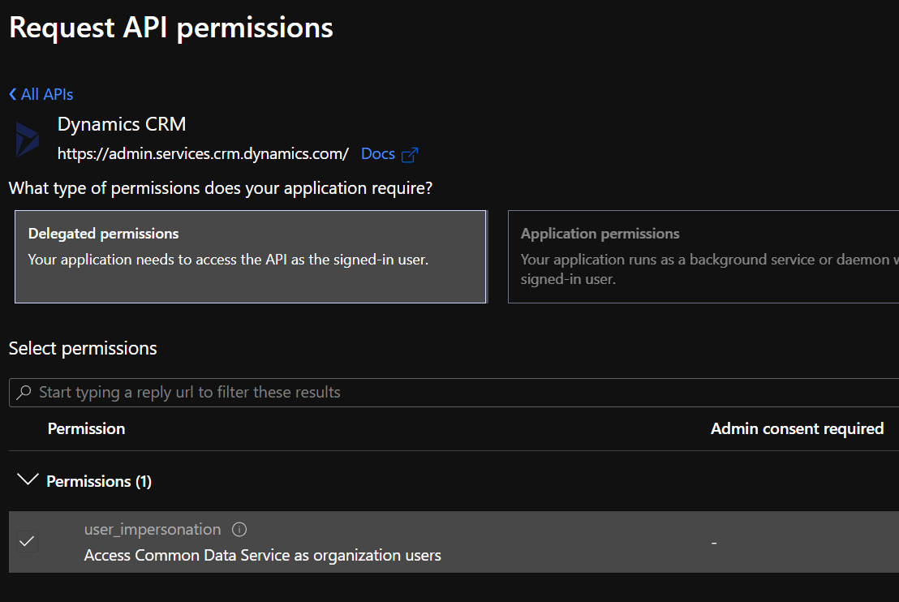
Steps - Active Directory (6/6)
Since the pipeline scripts must access D365, the API permissions must be set accordingly.
Open „API permissions“ in the App Registration and select „Add a permission“
Select „Dynamics CRM“ → „Delegated permissions“ → „Access Common Data Service as organization users“ and click „Add permission“
Depending on the customer process/setup, the Azure Admin Group must be notified to get the permission granted

Slide 11
Setup 2
D365 CE Application User Setup

Slide 12
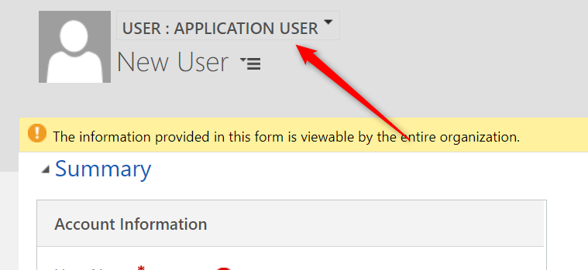
Steps – D365 CE Application User Setup (1/2)
The new App Registration can be mapped to a D365 Application User.
Open CE and navigate to Settings → Security → Users
Switch the View to „Application Users“ (this is important, otherwise creating a systemuser record will not work)
Click „+ NEW“ and change Form to „APPLICATION USER“(this is important, otherwise creating a systemuser record will not work)
Enter a Username, Full Name and Primary Email. The Email must not exist but it is recommended to use a valid address. E.g. To run a workflow and send an email from „CreatedBy“ of a record.

Slide 13
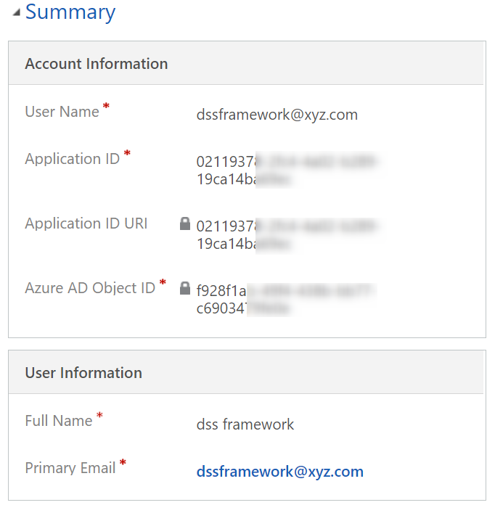
Steps – D365 CE Application User Setup (2/2)
Enter the ApplicationID and click „SAVE“ (the „Azure AD Object ID“ gets filled automatically as well as the „Application ID URI“)
Assign the required Security Role(s). If you did not configure an explicit Customizing-Admin Role, this must be either System Administrator or System Customizer since the pipeline is deploying Solutions and also pulls Solutions information to check version numbers etc.

Slide 14
Setup 3
Azure DevOps Library Setup

Slide 15
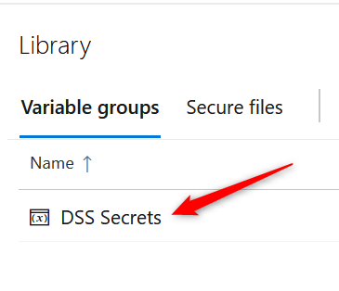
Setup Azure DevOps (1/2)
To enable the Pipelines to use the new Identity, a Library gets rolled our as part of the inital DSS Framework Setup.
Open DevOps and navigate to Pipelines → Library → DSS Secrets

Slide 16
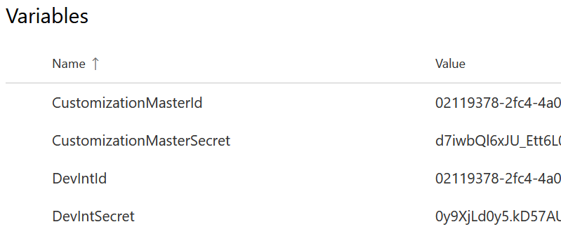
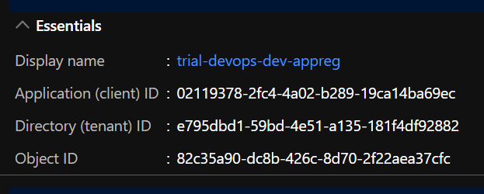
Setup Azure DevOps (2/2)
Depending on your setup (e.g. 1, 2 or complete Setup incl. Prod), configure the relevant Entries with the relevant ApplicationId and ClientSecret of your App Registration created in Setup 1. It is up to you/your client if you use the same Application ID for all environments. As usual, it is a best practice to separate the accounts (Dev/Test/QA/Prod).
Secret stored in Setup 1 – Step 3

Slide 17
Setup 4
Update Environment.json

Slide 18
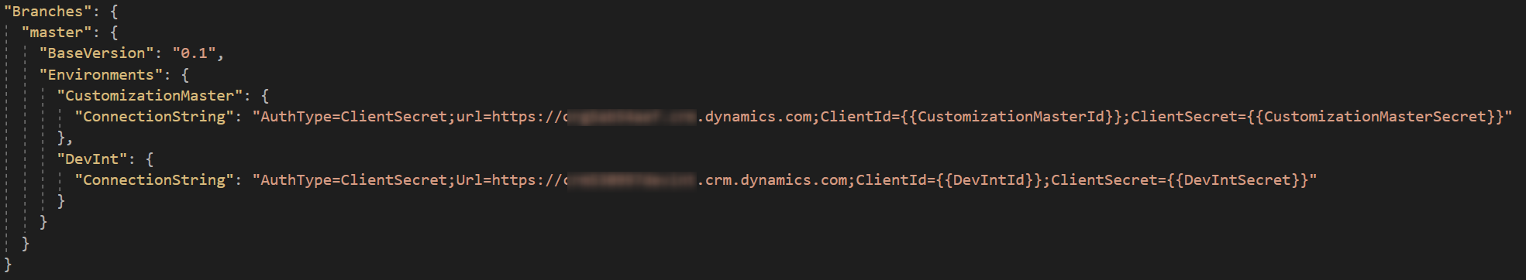
Setup Environments.json (1/2)
The Pipelines are fetching the Connection String from the Environments.json file which is stored in the „<root>\src“ folder of the cloned DSSFW repository.
Open the DSS Framework Solution which was cloned to the Developer System during the System Setup.
Open „Environments.json“ file and scroll to the bottom of the file.

Slide 19
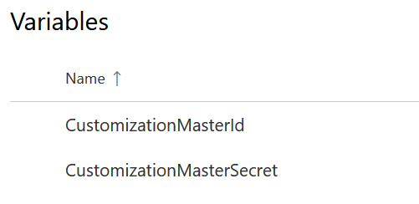
Setup Environments.json (2/2)
The ConnectionString must be in the format:
AuthType=ClientSecret;url=https://YOURORG.crm.dynamics.com;ClientId=YOURID;ClientSecret=YOURSECRET
Secret and Client must be in the format {{value-from-library-in-devops}}. For example:
CustomizationMasterId
CustomizationMasterSecret
As last step, this change must be pushed to the GIT branch (most likely Master during your initial Setup).

Slide 20
Backup

